Slide 1


welcome to our presentation
Importance of Reading Books

Slide 2
Physical and mental benefits of reading books
Gain knowledge : Reading books teaches new information , culture and perspectives.
Brain development : reading keep the brain active , improves memory and focus skills.
Peace of mind: reading helps to reduce stress.

Slide 3

Enhancing linguistic skills
Getting to know new word.
Improve grammar and language concepts.
Improve writing skills.

Slide 4
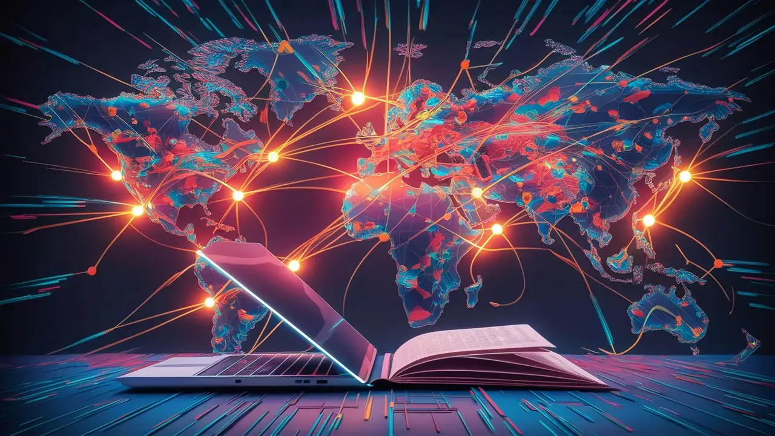
Integration with the world of information and technology
Familiarity with information technology and new trends by reading book.
By reading book, our vision is broadened and enriched.

Slide 5

Social and cultural development
Reading books increases empathy and humanity in people.
Awareness of different societies and cultures increases.

Slide 6
Conclusion
Life is enriched and human intelligence is developed by reading books. The habit of reading books helps to improve our thinking and thinking and quality of life. These are key points that can be include in your presentation. If you want, I can arrange things with more detailed information or images.

